Slide 1
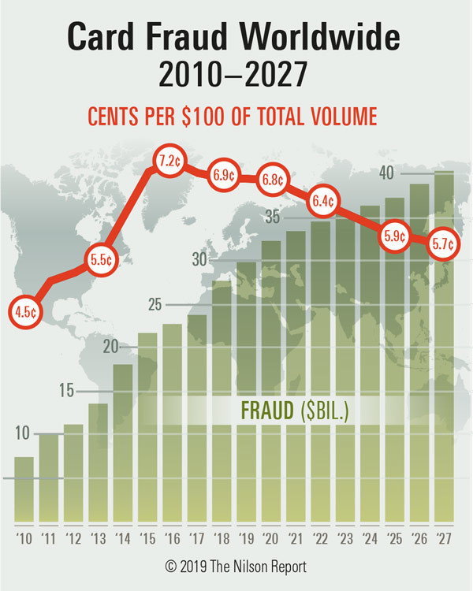
Machine Learning I - DATS 6202 11
Fall 2020
Final Project : Credit Card Fraud Detection
Dr.Yuxiao Huang
Abdulaziz Gebril
Mojahid Osman
Mina Hanna

Slide 2
Introduction
According to the FBI, credit card fraud is the unauthorized use of a credit or debit card, or similar payment tool (ACH, EFT, recurring charge, etc.), to fraudulently obtain money or property. Credit and debit card numbers can be stolen from unsecured websites or can be obtained in an identity theft scheme.
It is important that credit card companies are able to recognize fraudulent credit card transactions so that customers are not charged for items that they did not purchase.

Slide 3
Our challenge and objectives:
The nature of the card payment transaction and its attributes impose some challenges to have a standardized approach to build a fraud detection system. Challenges are mostly related to data imbalanced, data irregularity, security/anonymity, commercial and user impact of any solution.
→ In this project we will be working on Kaggle competition Credit Card Fraud Detection. The goal of the project is to be explore the different techniques to handle credit card data and compare different model performance against this data.

Slide 4
Dataset description:
The datasets we are using is project is contains transactions made by credit cards in September 2013 by european cardholders.
The dataset presents transactions that occurred in two days, where we have 492 frauds out of 284,807 transactions.
The dataset is highly unbalanced, the positive class (frauds) account for 0.172% of all transactions.
The dataset contains only numeric input variables which are the result of a PCA transformation.
Due to confidentiality most of features has been transformed V1, V2, … V28, except 'Time' and 'Amount'.

Slide 5
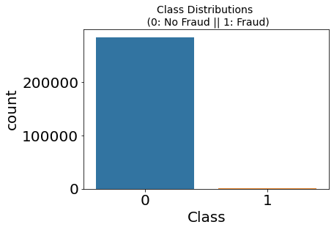
EDA :
Dataset is highly unbalanced, where we have 492 frauds out of 284,807 transactions which 0.172%

Slide 6
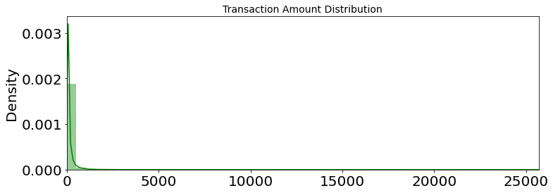
EDA :
Plots the two known variables (Transaction Amount and time).

Slide 7
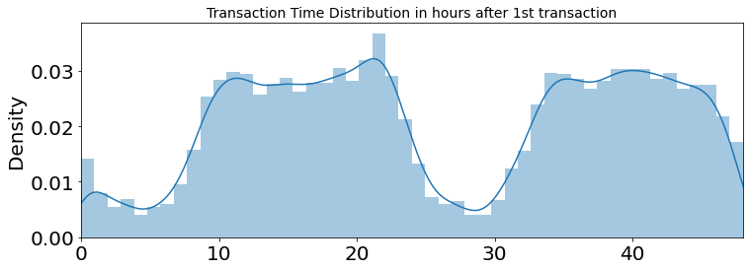
EDA
Distribution of the transaction traffic per time (day and night)

Slide 8
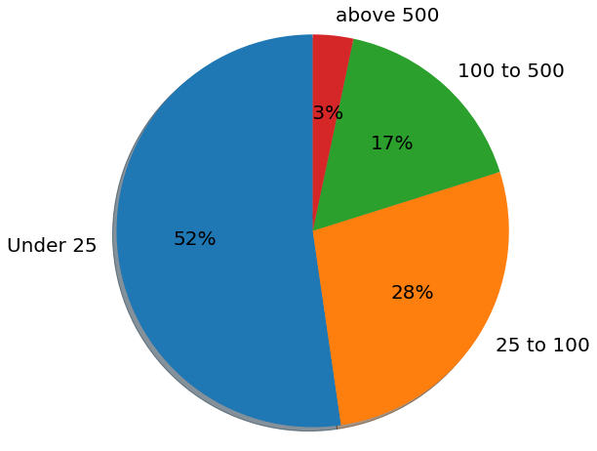
EDA
Card transaction amount distribution shows that more than half of the transactions are under 25 Euros while transactions above 500 Euros are less than 3%.

Slide 9
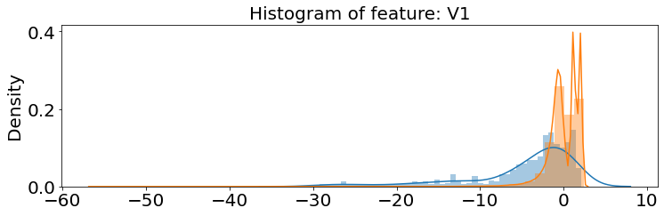
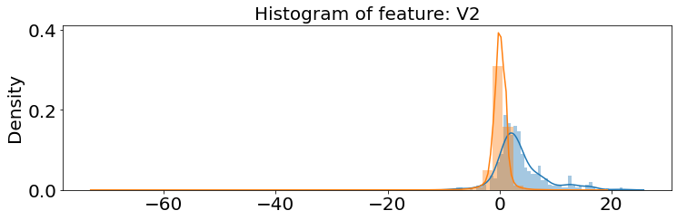
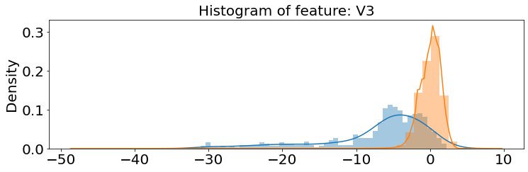
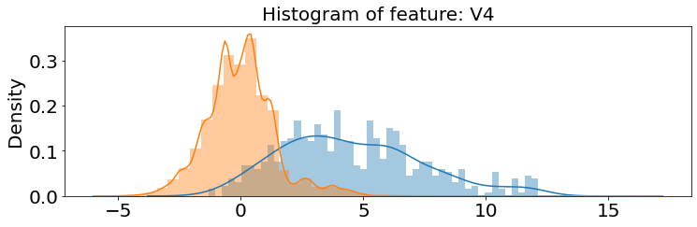
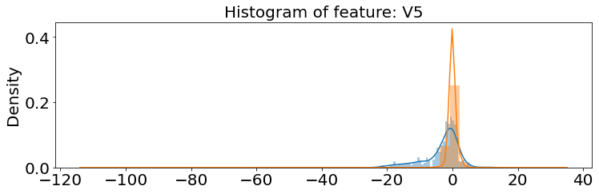
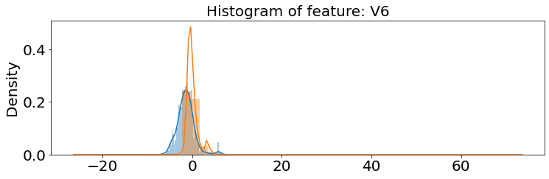
EDA
Plotting the classes distribution for all PCA component features

Slide 10
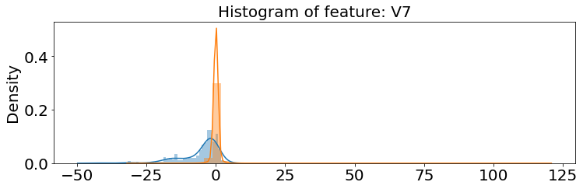
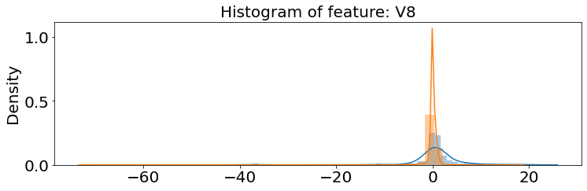
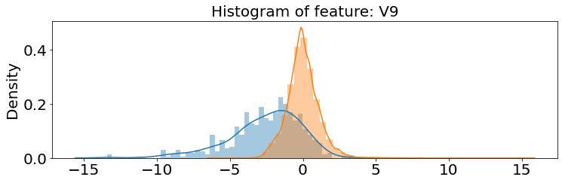
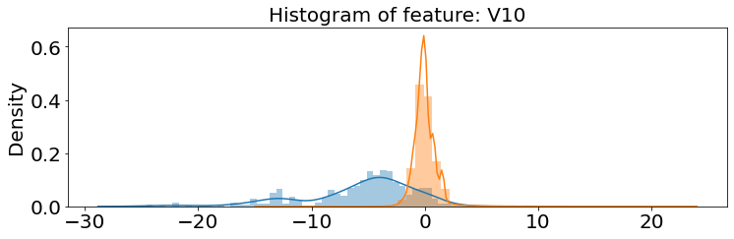
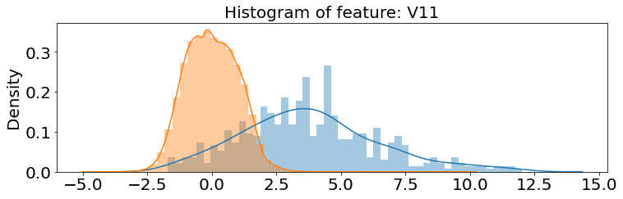
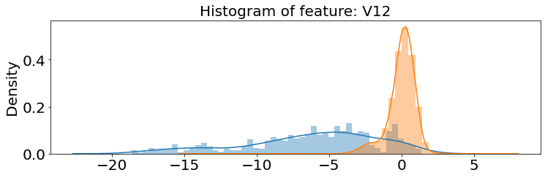
EDA
Plotting the classes distribution for all PCA component features

Slide 11
Preprocessing:
Split the data into Train and Test data
Split Train into Train and Validation
Convert time to a categorical field
Scaling the data

Slide 12
Pipeline approach:
Start
Load and explore the data
Undersampling
Handling class imbalance
Oversampling
Scale, remove outlier and undersample
Use SMOTE
Use ADASYN
LogisticRegression
MLPClassifier
DecisionTreeClassifier
LogisticRegression
FNN using two sets of training data (SMOTE and ADASYN)

Slide 13
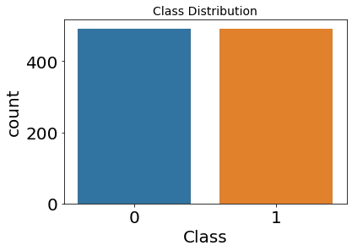
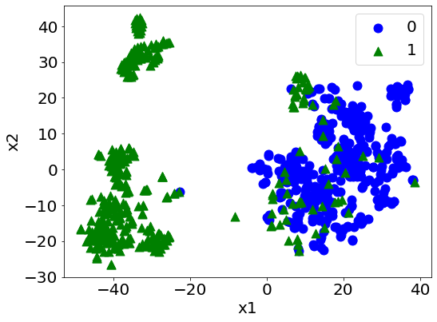
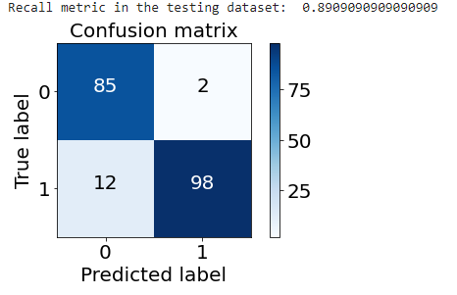
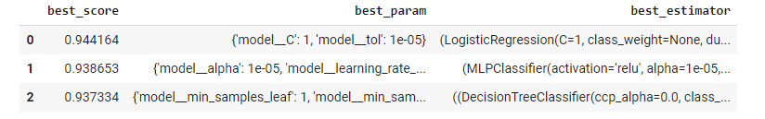
Undersampling
Distribution of the Classes in the undersampled dataset
Applying our shallow models

Slide 14
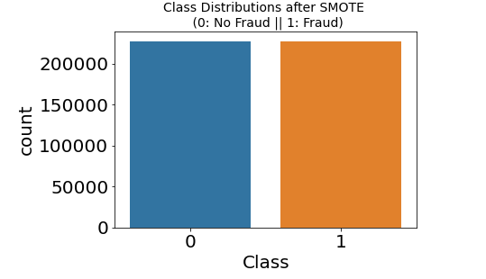
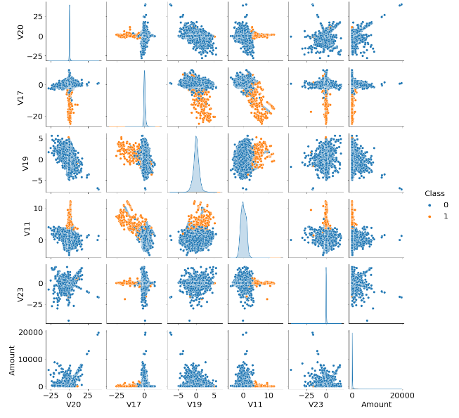
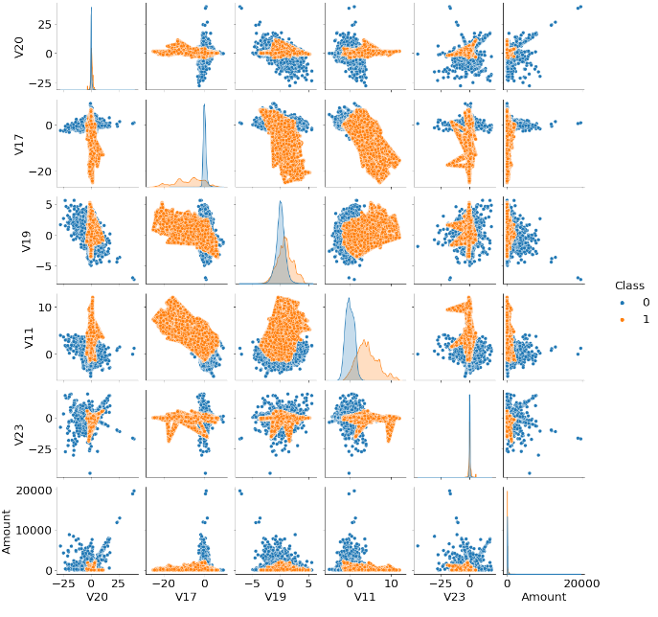
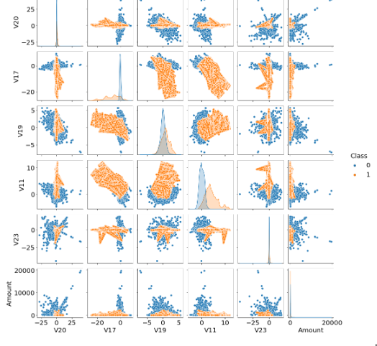
Oversampling - SMOTE
Distribution of the Classes in the oversampled dataset

Slide 15
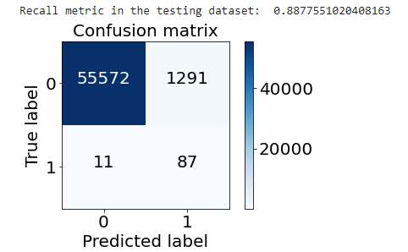
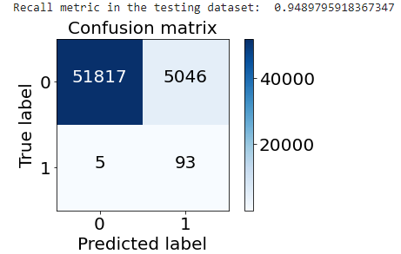
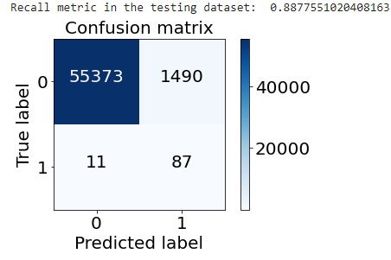
Logistic Regression comparison
SMOTE
ADASYN
Undersample dataset
Oversampled dataset

Slide 16
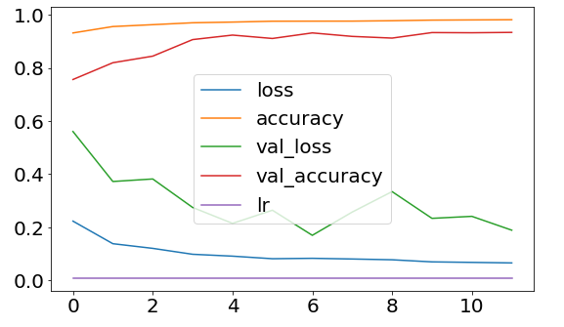
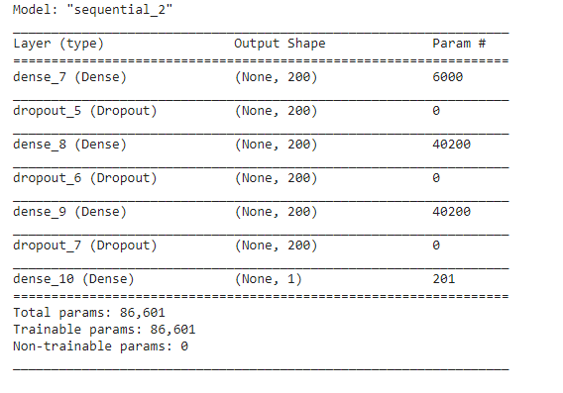
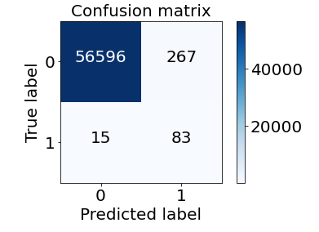
Neural network models SMOTE

Slide 17
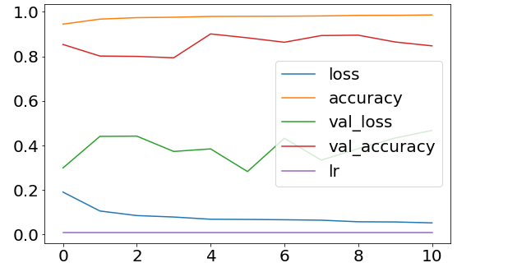
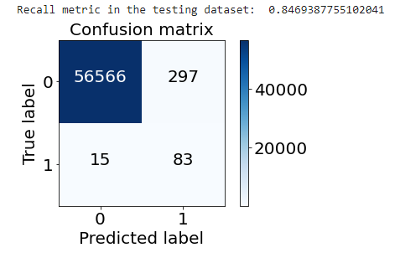
Neural network models ADASYN

Slide 18
Conclusion
Focusing on the minority class:
Undersampling resulted in significantly high recall with low precision
Models using oversampled data resulted in significantly high precision but lower recall when compared to models using undersampled data
SMOTE or ADASYN resulted to a very similar model performance
DNN Using oversampled dataset resulted in the best balance between recall and precision
Minority class best model performance
 | Undersampling | Undersampling after outlier removal | Oversampling - LR | Oversampling - DNN
Precision | 3.92% | 1.8% | 6.3% | 23.7%
Recall | 90.8% | 94.9% | 88.8% | 84.6%

Slide 19
Model selection criteria
How payment networks evaluate fraud prevention models (rough estimate):
Value of fraud prevention gains due to true negative (FG)
Value of lost interchange revenue due to false positive (IL)
Loss interchange revenue should exceed gains from fraud prevention
FG = AVG(Transaction Amount) (TN - FN)
IL = FP * AVG(Transaction Amount) * Interchange
Assumptions:
AVG Transaction Amount in the test dataset is 78.5 Euros
Interchange is 2% from the Transaction Amount
Using the test dataset
 | Recall | FG | IL | Net Gain
Undersample w/o outliers | 94.9% | 6908 | 7922 | - 1014
Undersample LR | 90.8% | 6280 | 3422 | + 2857
Oversample LR | 88.8% | 5966 | 2026 | + 3939
Oversample DNN | 84.6% | 5338 | 419 | + 4918

Slide 20
Thank you

Slide 21
The data challenge
The nature of the card payment transaction and its attributes impose some challenges to have a standardized approach to build a fraud detection system. Some of these challenges are explained in the following list:
Data irregularity: As highlighted in the previous section, credit card transactions data are highly imbalanced because only a very few fraction of the transactions are fraudulent
Secure nature of the data: The credit card data and other attributes has to follow different security regulations with regards to confidentiality and privacy which restrict the sharing of the data between multiple institutions.
Precision and recall impact: The criteria of model selection has to consider the high impact of false negative compared to false positive classification
Commercial aspects and user experience: Since the majority of credit card transaction are not of a very high dollar value, the cost of prevention and the impact to the user experience in terms of speed has to considered when processing the data and defining the best model

